Slide 1


Slide 2

K-MEANS & FRIENDS
EXPLORING CLUSTERING WITH PHOTOGRAPHS
shaurya agarwal

Slide 3

Outline
motivation
movie
math
method
more

Slide 4
motivation
what are we talking about again?

Slide 5
quantization, clustering, k-means and friends
Image Compression, Customer Segmentation, Document Clustering, Anomaly Detection, Feature Learning and Dimensionality Reduction, Medical Imaging, Genomics and Bioinformatics, Speech Recognition, Astronomical Data Analysis, Pattern Recognition and Classification, even enabling efficient training for LLMs
…and unusually enough, a movie

Slide 6
movie
cinematography: a rather unusual use case for k-means

Slide 7

i got to do this
cinematography
on
a
budget
powered
by
python
Notes:
https://commons.wikimedia.org/wiki/File:Feynman-richard_p.jpg?uselang=en#Licensing

Slide 8
first principles
the best cinematography has exceptional control on color

Slide 9
first principles
showcase what inspired the film’s cinematography

Slide 10
first principles - colors
one, or two or a few
Notes:
see this: https://www.youtube.com/watch?v=YCJXS4hvOsU

Slide 11
first principles - colors
one, or two or a few but no more

Slide 12
first principles - colors
the director ascribes meaning to these one, two or a few to tell the story

Slide 13
first principles - colors
these colors must remain (approximately, perceptually) consistent
throughout the process, across all devices and screens

Slide 14
pre-production
or else*
* I had a great director and a very very dedicated team, use your imagination

Slide 15
pre-production
there are expensive cameras and studio setup that offer great control over the process

Slide 16
pre-production
a typical day may cost 100s of 1000s of $$$ for camera and lighting

Slide 17
pre-production
but for a 10-day shoot, interior and exterior

Slide 18
pre-production
we had USD 359 total
(yes, that’s three hundred and fifty-nine dollars, at the current exchange rate)

Slide 19
pre-production
I used K-means to figure out the key colors in each scene
and tell a story around them

Slide 20
key insight
light – waves – wavelength, wavelength, wavelength

Slide 21
key insight
light – colors – long wavelength, medium wavelength, short wavelength

Slide 22
key insight
film and camera sensors do too, but differently

Slide 23
CIE XYZ 1931
they devised a standard based on how human eyes respond to various wavelengths

Slide 24
CIE Lab*
3 dimensional model (we have 3 cones remember) to represent how we see color

Slide 25
ACES, ARRI, SONY, sRGB, Rec.709, Rec.2020, etc. etc.
all models build up from the perceptual model – this is how all films manage color

Slide 26
color mastering
so the colors we decided on with the director, had to be identified at a perceptual level and kept consistent throughout the production as the information travelled from the camera sensor to the computer monitor to the cinema projector to the mobile phone and laptop screens…

Slide 27
color mastering
long wavelength, medium wavelength, short wavelength
if i could capture the key colors perceptually, i can manage the rest of the process

Slide 28
how do you pick colors?
google ‘QUANTIZATION’

Slide 29
how do you pick colors?
i used k-means++ to do it

Slide 30
.
let’s see how
there really is no math to it...

Slide 31
math*
how clustering works

Slide 32

naïve explainer
imagine you have a bunch of marbles of different colors, and you want to organize them into groups

Slide 33
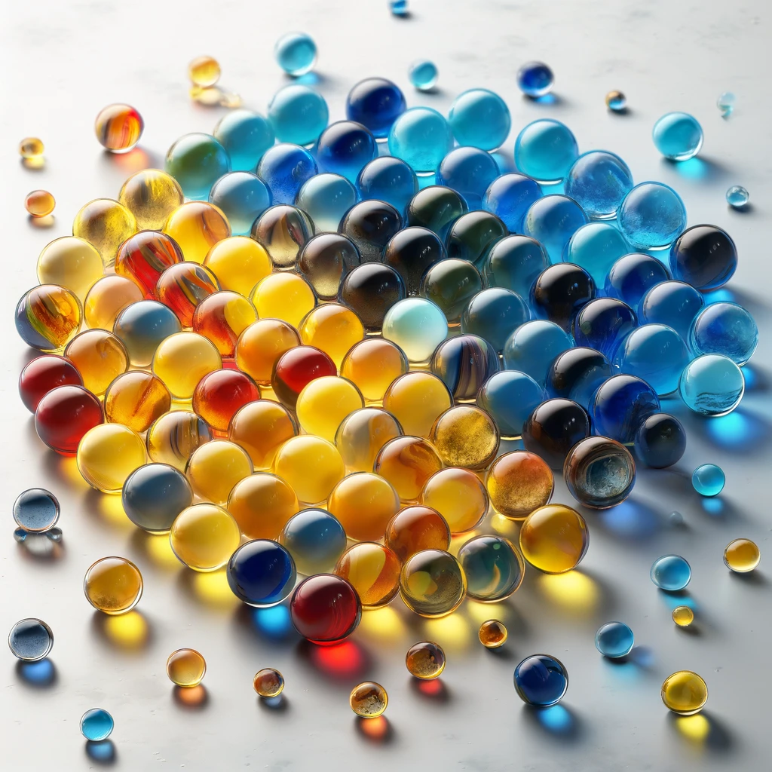
naïve explainer
the k-means method is like deciding to group the marbles
based on how close they are to each other (in color)

Slide 34
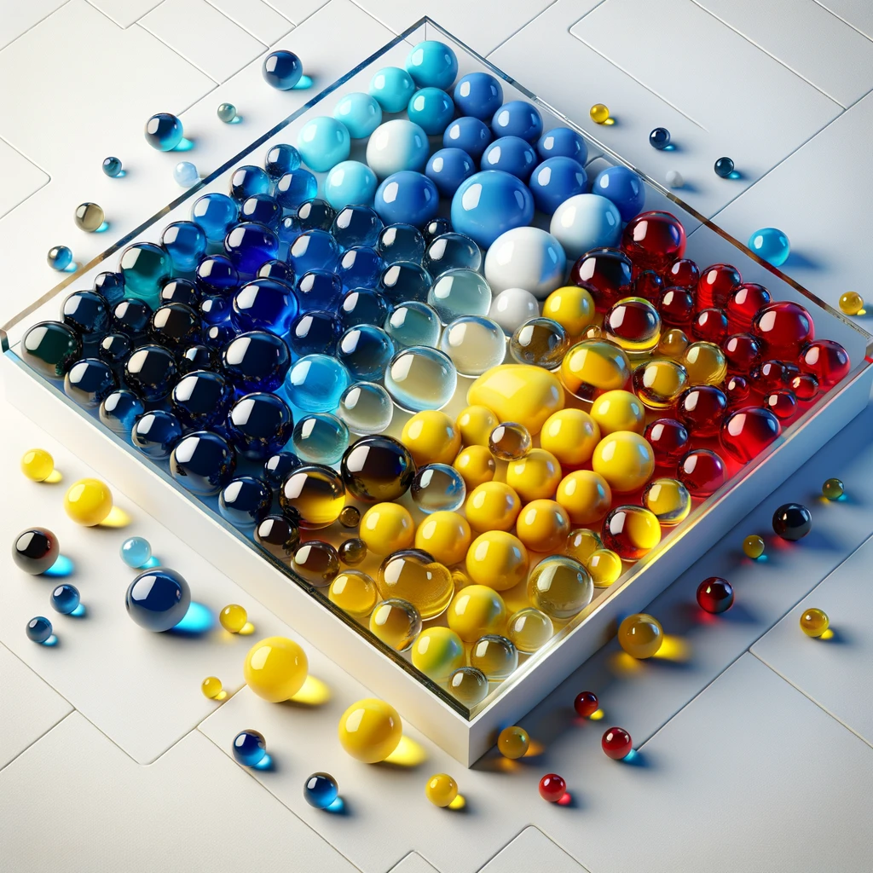
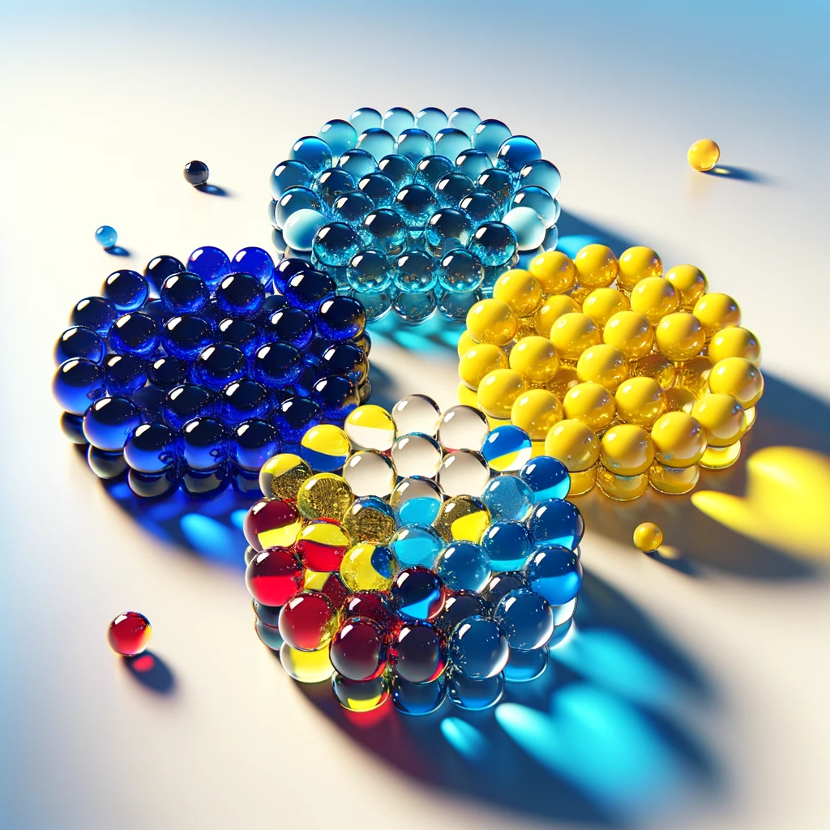
naïve explainer
the "k" in k-means is deciding how many groups you want

Slide 35
technically
K-Means is a clustering algorithm used in machine learning and data mining to partition n observations into k clusters in which each observation belongs to the cluster with the nearest mean. This results in a partitioning of the data space into Voronoi cells.

Slide 36
steps
Initialize
Assign
Update
Repeat

Slide 37
steps
Initialize
Start by selecting k initial centroids, where k is a predefined number of clusters
Initialize
Assign
Update
Repeat

Slide 38
steps
Assign
each data point to the closest centroid, creating clusters
Initialize
Assign
Update
Repeat

Slide 39
steps
Update
Recalculate the centroids as the mean of all points in each cluster
Initialize
Assign
Update
Repeat

Slide 40
steps
Repeat
the assignment and update steps until the centroids no longer change significantly, indicating convergence
Initialize
Assign
Update
Repeat

Slide 41
steps
Limit
Often the centroids do not seem to converge, but dance around the convergence points, this is when we stop the algorithm by specifying the maximum number of iterations
Initialize
Assign
Update
Repeat
Limit

Slide 42
framework
Representation
Distance Measure
K

Slide 43
framework
Representation
feature comes in focus
unit distances mean the same thing everywhere.
Examples from other domains:
When clustering customers, ensure they are using the same currency
When clustering time related data, ensure everything relates to the same time zone (or UTC)
Representation
Distance Measure
K

Slide 44
framework
Distance Measure
how you measure measures your model
Examples from other domains:
…
Representation
Distance Measure
K

Slide 45
framework
The Right K: Elbow Method
Plot the cost (e.g., within-cluster sum of squares) against different k values. The "elbow" point, where the rate of decrease sharply changes, can indicate a good k value.
Representation
Distance Measure
K

Slide 46
framework
The Right K: Silhouette Score
Measure how similar an object is to its own cluster compared to other clusters. A high silhouette score suggests the object is well matched to its own cluster and poorly matched to neighboring clusters. The k that maximizes the average silhouette score may be chosen.
Representation
Distance Measure
K

Slide 47
framework
The Right K: Gap Statistic
Compares the total within intra-cluster variation for different values of k with their expected values under null reference distribution of the data. The k with the highest gap statistic suggests the optimal clustering.
Representation
Distance Measure
K

Slide 48
how?
let’s see this in action

Slide 49
method
let’s look at some code

Slide 50
tech stack
this is compute intensive
we leverage vectorized, just-in-time approach

Slide 51
tech stack
JAX parallelizes and optimizes the compute DAG over numpy

Slide 52
code
switch to code

Slide 53
MORE
JOIN THE DISCUSSION, GITHUB, MAKE THIS BETTER

Slide 54
open-source
Eight Down Toofaan Mail is now on YouTube https://www.youtube.com/watch?v=VnHPtozfhRU
this project on github: https://github.com/shauryashaurya/kandinsky
join me

